Slide 1


RIVERFRONTS ARE TO BE ENJOYED
41 YEARS AND COUNTING
www.riveraction.org

Slide 2
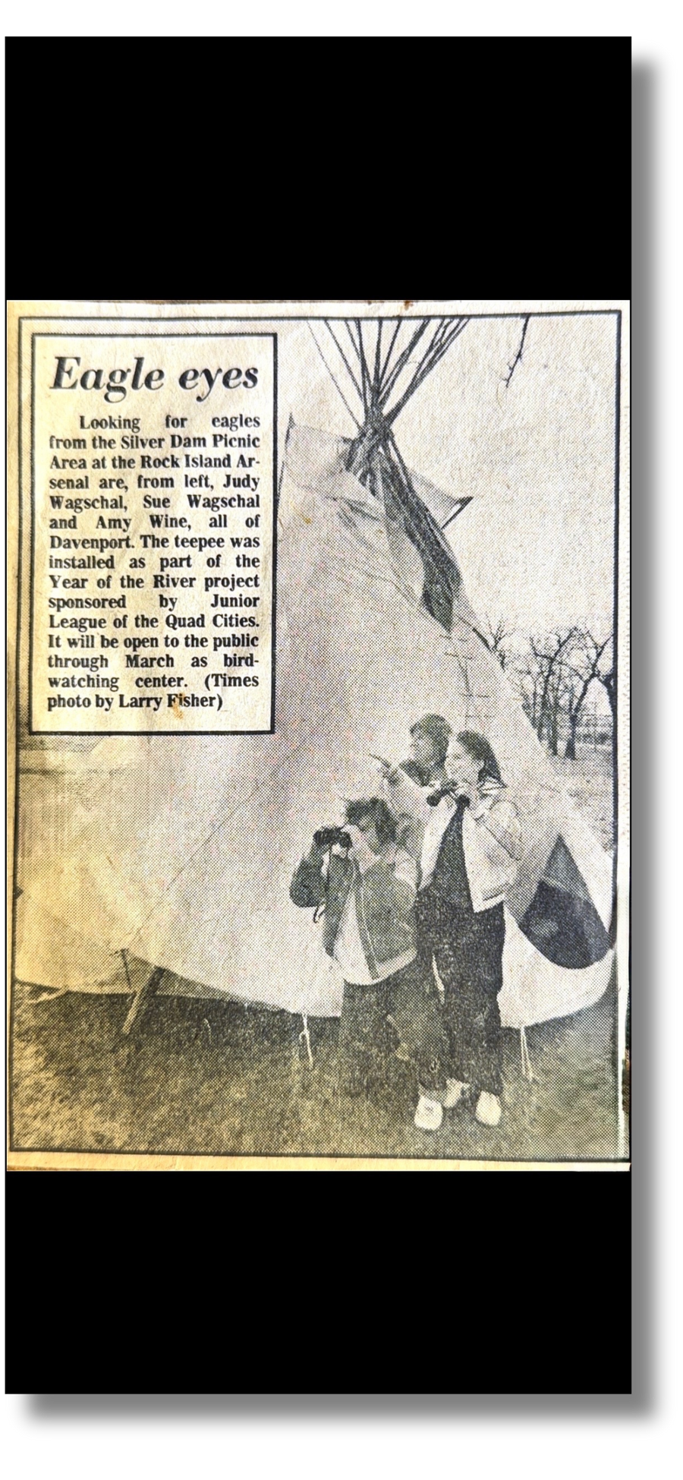
January: View the Eagles From a Tee-Pee
On Arsenal Island with view of dam
Hot chili over open fire
Hot chocolate
Viewing scopes

Slide 3

Promotional Campaign
30,000 brochures
Calendar of events supplement to Quad City Times
Year of the River song to local radio and TV stations
Joined By a River logo on t-shirts, telephone books, billboards, tote bags, bottles of Mississippi River water, and distribution of logo to any organization that wanted to use it.

Slide 4

Quad City Marathon and Year of the River Regatta
Run on riverfront streets and bridges.
All five boat clubs collaborated for the first time on:
Sailboat racing
Water skiiing
Boat parade
Boat safety demonstrations
bands, food, wind sailing, and ‘yacht open houses’
Promoted the Quad Cities as being joined by the Mississippi River

Slide 5

Speakers Bureau
•Presentations to civic groups once a week for entire year
•Promoted Beautification Trust Fund donations

Slide 6
Dream of the River in the Year 2000
•Collaboration with School of Design, Iowa State University
•Designs for 22-mile area of Quad City riverfront
•Placed in local museums, libraries, colleges, bank lobbies, etc.
•89-page design studies booklet placed with display

Slide 7
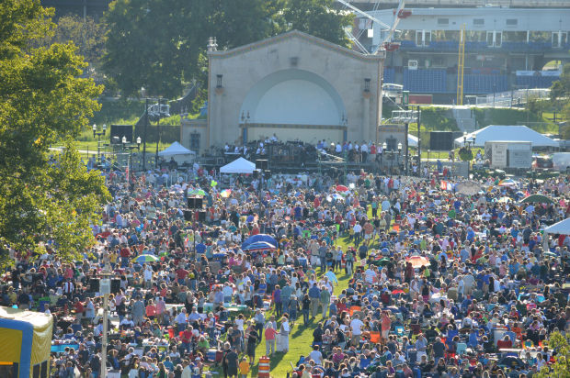
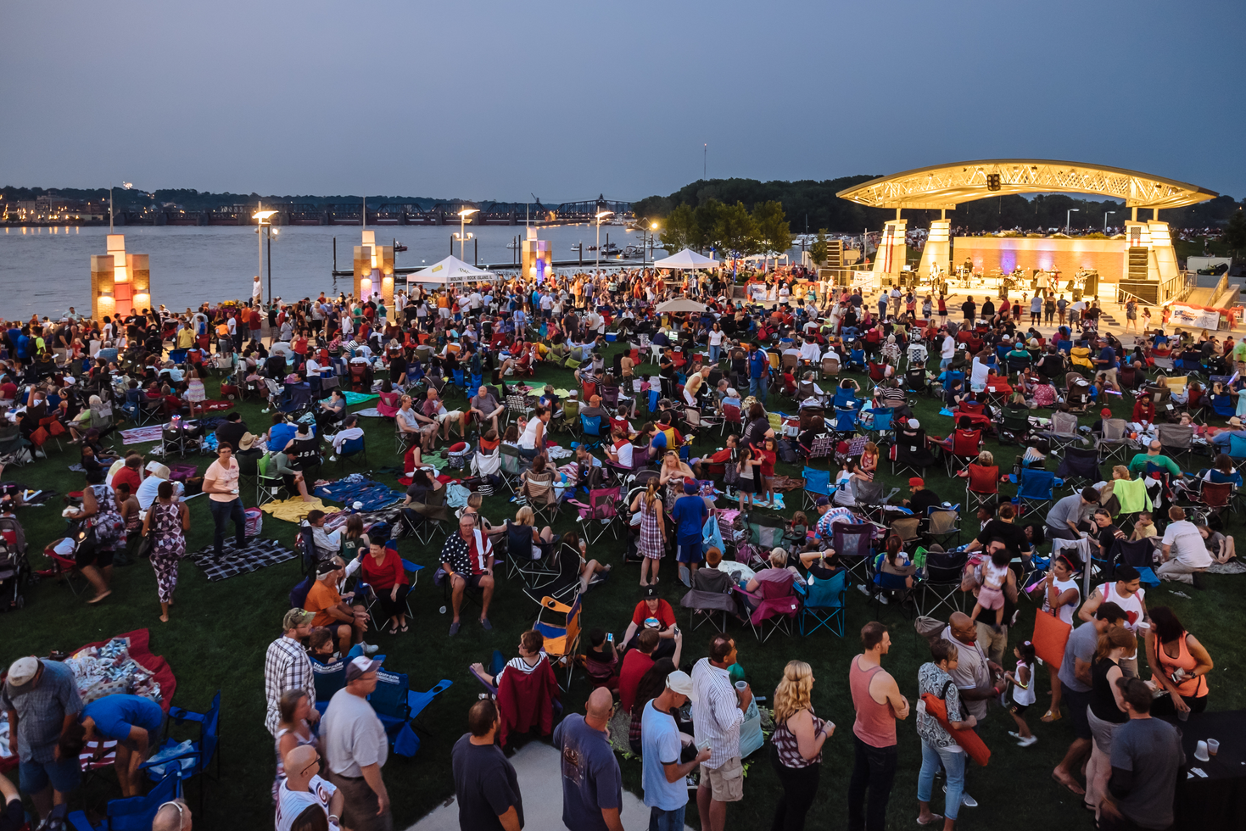
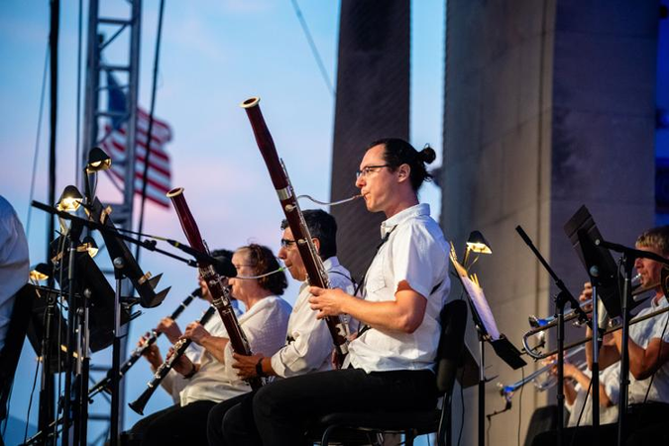
QC Symphony
Riverfront Pops Concert
•6,000 in attendance for first-ever riverfront concert by QC Symphony

Slide 8
Time and the River
•A play by local playwright Julie McDonald
•About our river heritage
•Presented at Black Hawk State Historic Site

Slide 9
Beautification Projects
•Lighthouse Park on Davenport’s East River Drive
•17th Street Park Poject at foot of Moline’s 17th Street

Slide 10
Humanities Programs
•Guided Tours on working towboats for the public—May—July
•Guided Tours on Biology Houseboat –St. Ambrose University
•“Mark Twain in Person”: Circa 21 Playhouse

Slide 11
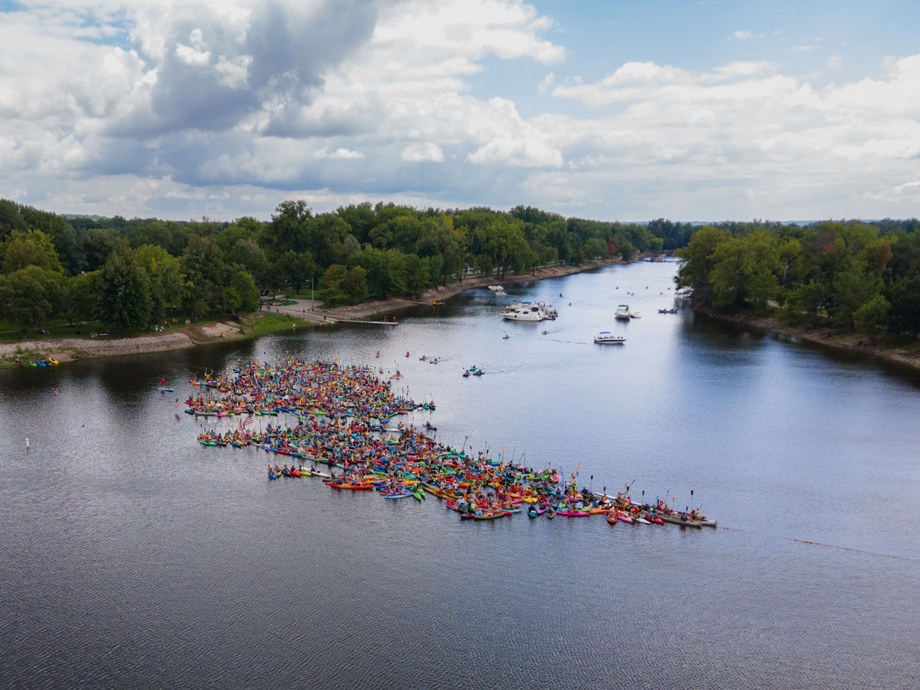
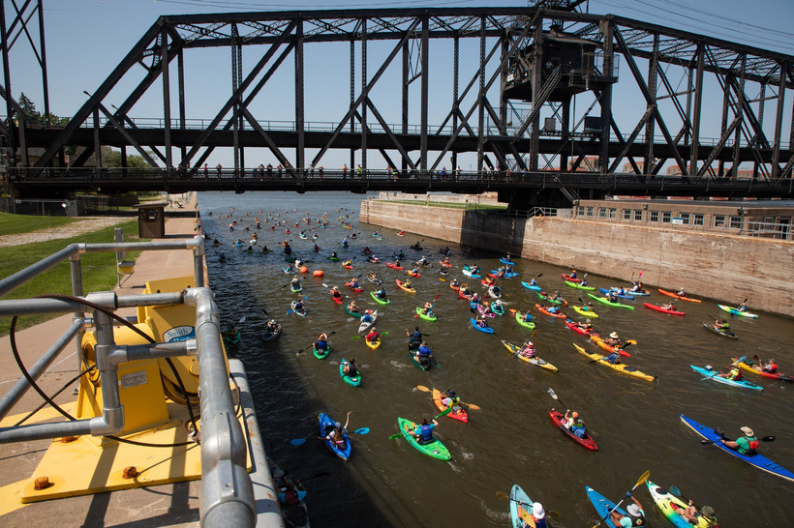
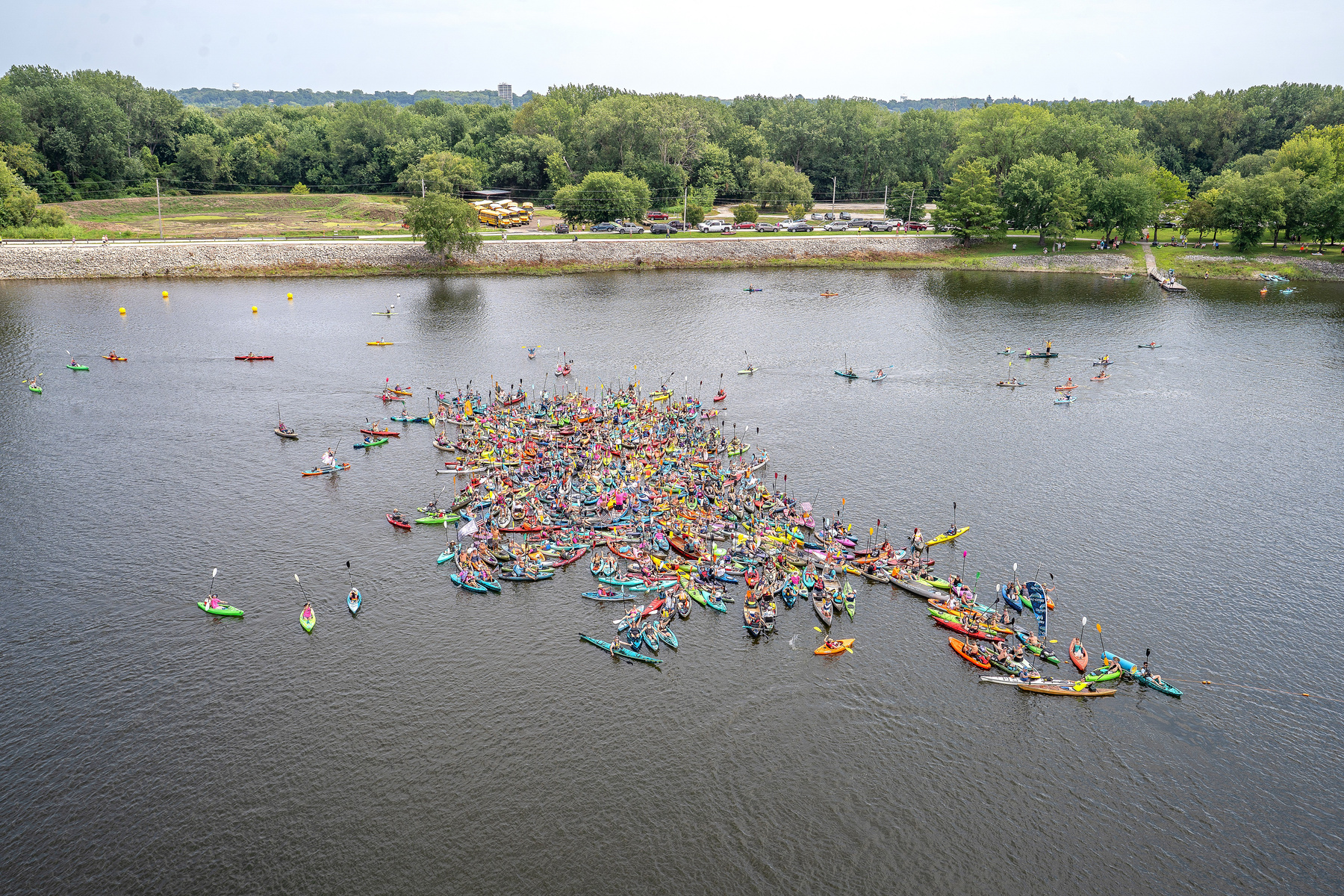
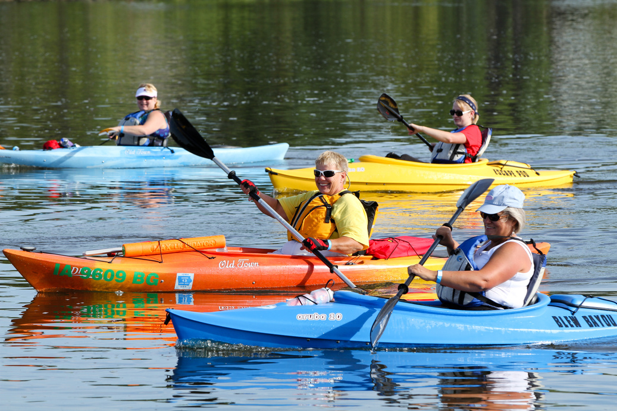
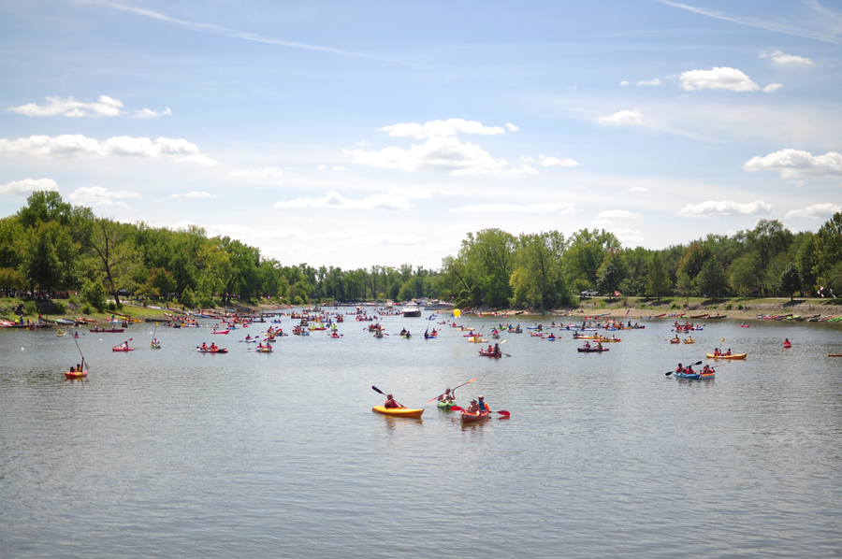
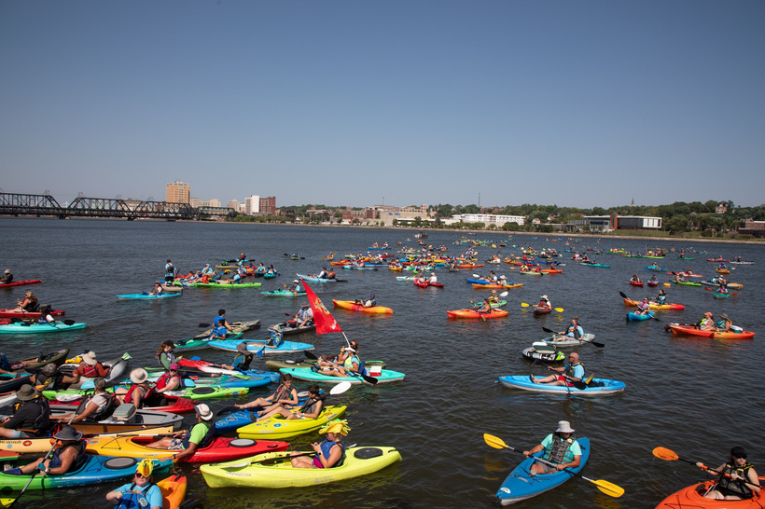
FLOATZILLA
The Largest Paddle Event on the Mississippi

Slide 12






EVENTS & PROGRAMS
Explore
the
River
FLOATZILLA
TAMING OF THE SLOUGH
EXPLORE THE RIVER
RIDE THE RIVER
River Action's annual paddle event on the Mississippi River lets paddlers will launch from eight sites across the Quad Cities to take over the river for the day.
River Action’s annual adventure triathlon takes place on the Mississippi at the Sylvan Slough and on Sylvan Island. All skill levels paddle, ride, and run this race.
River Action’s Summer Program, the Explore the River Series of Channel Cat Talks & Riverine Walks, teaches about nature history, and culture of our river
River Action’s Father’s Day bicycle event is for all ages. Families, groups, and cyclists ride the riverfront trails. In 2025 they road the trails of Arsenal Island.
FLOATZILLAQC.ORG
TAMINGOFTHESLOUGH.ORG
RIVERACTION.ORG/EDUCATION
RIVERACTION.ORG/RIDE

Slide 13
THANK YOU
Visit riveraction.org/whatwedo to learn more.

